Slide 1
Mid capstone Project Presentation Analysis of Rental Patterns and Film Popularity in Mavenmovies Database
Shridevi G
S9696

Slide 2
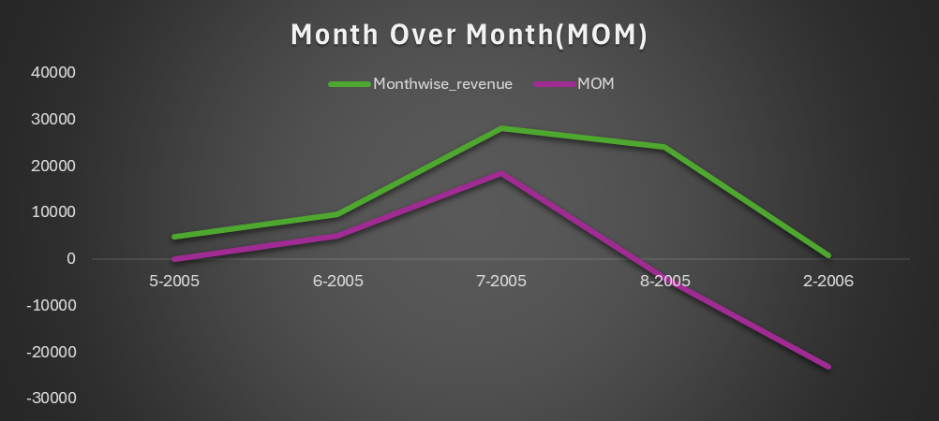
Monthly Rental Trends
with monthly_rental as
(
select year(rental_date) as year, month(rental_date)as month, sum(amount)as Monthwise_revenue
from rental
left join payment on rental.rental_id=payment.payment_id
group by year,monthorder by year,month
)
select *,
Monthwise_revenue-lag(Monthwise_revenue) over(order by year,month)
as MonthOnMonth
from monthly_rental
group by year, month;
This report shows the month-wise revenue based on the year and month and Month-over-Month
Monthly rental trends shows a down-trend

Slide 3
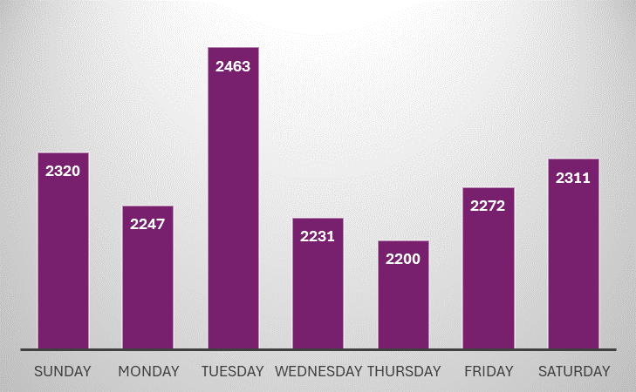
Peak Rental hours
select dayname(rental_date)as Renting_Day,
hour(rental_date)as hours,count(*)as peak_rental_hours
from rental
group by Renting_Day,hours
order by peak_rental_hours desc;
…
These tables show the peak rental hours and on which day of the week has the rush hour.
Based on the chart, Tuesdays have more rental hours

Slide 4
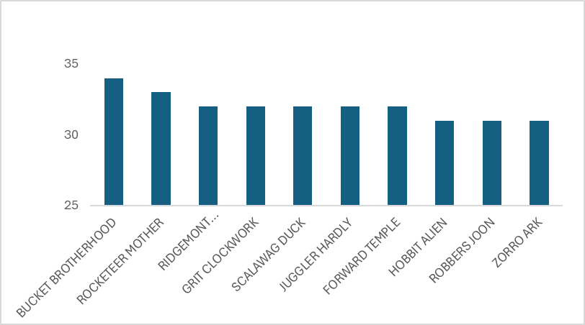
Top 10 most rented movies
These are the Top 10 most rented movies

Slide 5
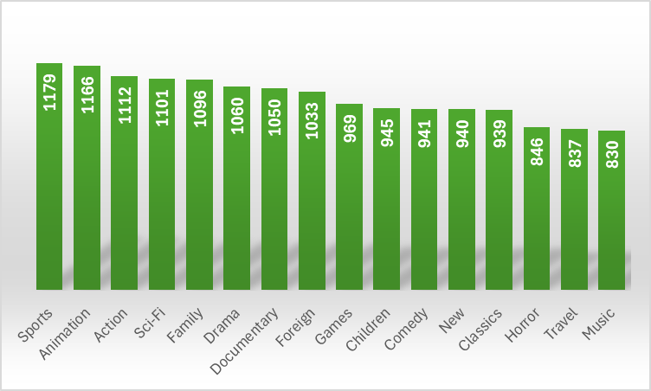
Highest number of Rentals
select name as Film_Category_Name,count(rental_id)as Number_of_Rentals
from category
left join film_category on category.category_id=film_category.category_id
left join inventory on film_category.film_id=inventory.film_id left join rental on inventory.inventory_id=rental.inventory_id group by Film_Category_Name
order by Number_of_Rentals desc;
Customers prefer to watch more sports movies compared to other movies

Slide 6
Highest rental revenue
select store.store_id, sum(amount)as Highest_Rental_Revenue
from store
join staff on store.store_id=staff.store_id
join payment on staff.staff_id=payment.staff_id
group by store_id
order by Highest_Rental_Revenue desc
Limit 1;
Store ID 2 has the highest rental revenue compared to Store ID 1

Slide 7
Staff Performance
select staff.staff_id, concat(first_name," ",last_name)as Staff_Name, count(rental_id)as Rental_Count
from staff
join rental on staff.staff_id=rental.staff_id
group by staff_id,Staff_Name
order by Rental_Count desc;
Based on these data Staff ID 1 has performed better than Staff ID 2

Slide 8


